Slide 1

Ideas of Machiavelli
Aim/Goals: To what extent are the ideas of Machiavelli alive today?
Do Now: Analyze this quote:
“It is better to be feared than loved…”
In a few sentences what do you think this means?
Homework: How did the writings of Machiavelli reflect Renaissance beliefs? Why would the Catholic Church be critical of some Renaissance writers?

Slide 2
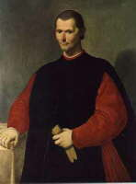
The Prince
Author: Niccolo Machiavelli
Culture: Italian (another Florentine)
Time: 1513 CE
Genre: didactic prose handbook
Name to Know: Cesare Borgia

Slide 3
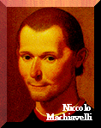
Background
Son of a lawyer.
Received an ordinary literary education; read Latin but no Greek.
Loved Roman history; studied law.
Became a political writer & theorist.
Worked as a clerk, then secretary to the second chancery of the commune in Florence (14 years).

Slide 4
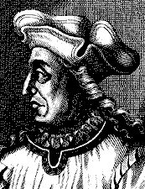
Practical Experience
As secretary & Second Chancellor of Florence, in charge of internal and war affairs, he had knowledge of military & diplomatic matters; went on diplomatic missions.
After arguing against mercenaries and for a national militia, he was given the job of forming one and leading it to battle. Did so successfully(1509).

Slide 5
Another Florentine Exile . . .
He lost his position and was exiled from Florence when the republican regime went out of power; forbidden to leave Florentine territory, he was imprisoned and tortured, accused of conspiracy by the new Medici regime.
After he was released, he retired with his wife and children, wrote The Prince, among other things. Later got into Medici good graces (1520s). Died in 1527.

Slide 6
Reaction to Change
Machiavelli’s life changed drastically when the Medici family took power in Florence.
How does he react to this?
Compare with how Abelard and Dante dealt with the unforeseen events in their lives (castration, exile).
How would Marie de France judge their reactions to unexpected change, the test of unforeseen events ?

Slide 7
His Importance
An historian summed Machiavelli up thus:
‘Diplomat, historian, dramatist, philosopher; the most cynical thinker of his time, and yet a patriot fired with a noble ideal; a man who failed in everything he undertook, but left upon history a deeper mark than almost any other figure of the Renaissance.’ [Durant]

Slide 8
Machiavelli was an independent and fearless thinker about ethics and politics:
interested in states, not individuals
[individuals are simply members of states]
wants to know why states rise & fall
wants to know how to delay state decay

Slide 9
The Prince
A manual teaching how to get and keep political power. The author assumes a pedagogical persona, seeks to persuade readers.
The work is powerful for:
subject matter
rhetorical & technical brilliance
Among the most frequently reprinted books in any language.
Dedicated first to Giuliano de’ Medici, then to Lorenzo, his nephew.

Slide 10
Structure
26 Chapters:
1-11: different types of dominions; ways to
acquire and keep them.
12-14: problems of military power.
15-26: attributes and ‘virtues’ of the prince
himself: an idealized portrait of a
certain kind of person [amoral &
efficient prince]

Slide 11
The presentation of an ideal character is a Renaissance tendency.
Author’s premise: human nature is evil;
human nature remains constant over time.
Author’s goal: to liberate Italy from both internal warring and foreign oppression.

Slide 12
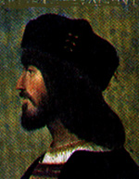
The Prince, Almost
Machiavelli admired Cesare Borgia, son of Pope Alexander VI, makes him an embodied will to power, a model for supermen, beyond good and evil.

Slide 13
Borgia’s Accomplishments
Destroyed his disloyal generals, having first made their supporters his own.
Put Remirro de Orco in charge of Romagna. He pacified the province and united it (the bad guy); Borgia then instituted civil courts (good guy).
Had Remirro killed and displayed in public square. “The ferocity of this spectacle left those people at the same time gratified and awe-struck.”

Slide 14
Selections Read
Chapter 6: On New Principalities Acquired by Means of One’s Own Arms & Ingenuity.
He holds out several as examples: Moses, Cyrus, Romulus, Theseus.
What does he say they have received from fortune? (p. 248)
Why do they have problems upon winning a new place?

Slide 15
The Qualities of a Strong Prince
Chapter 18: How a Prince Should Keep His Word.
When should a Prince keep his word? When not?
What is the most important quality for a Prince to seem to have?
Chapter 25: How Much Fortune Can Do in Human Affairs and How to Contend with It.

Slide 16
Final Words
Chapter 26: Exhortation to Take Hold of Italy and Liberate Her from the Barbarians.
At the end he quotes a poem of Petrarch, urging on a war to unite Italy and drive out foreign powers “for the ancient valor in Italian hearts is not yet dead.”

Slide 17
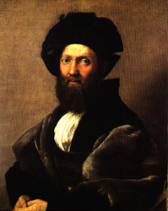
The Book of the Courtier
Author: Baldesar Castiglione
Culture: Italian
Time: 1528 CE
Genre: didactic prose handbook
Names/terms to know: Guidobaldo, sprezzatura, Ludovico.

Slide 18
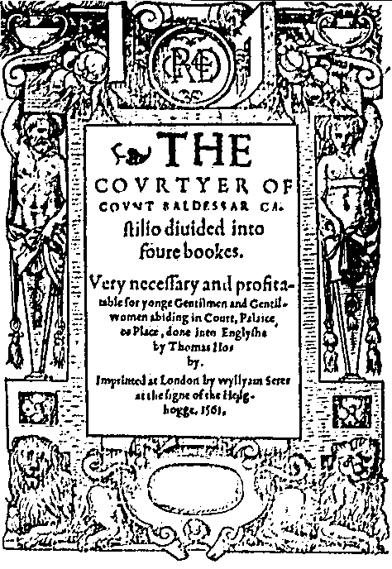
A 1561 Edition Title Page

Slide 19
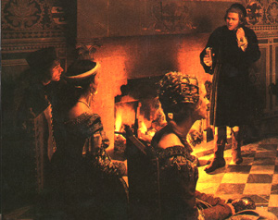
Court Life
Dominated by sprezzatura: the fine art of apparently effortless performance; or, nonchalance.
Castiglione grew up in court, as the son of a courtier. Became a diplomat in court of Urbino; made a count, then bishop.
Sack of Rome by Charles V shocked him into illness; he died in 1529.

Slide 20
Ideals of the Italian Renaissance
The Book of the Courtier gives a deeply felt account of them, embodied in the qualities of the complete and perfect courtier: discretion and decorum, nonchalance and gracefulness. C. wrote it after the death of Duke Guidobaldo, wanting to honor & repay an emotional debt to the man who had created such a splendid court.
It is also a comedy of manners, popular among the middle as well as upper classes.

Slide 21
Structure
Four books representing four nights following a papal visit to Urbino, during which the principals of the court converse together.
The Duchess presides over the gathering.
Speakers: not authoritative; put on different ‘masks’ and must be prevailed upon to speak (part of the game).

Slide 22
Deference as Social Armor
Unlike the 10 nobles in the Decameron, the courtiers here must constantly negotiate differences caused by class, sex, city-state and religious temperatment.

Slide 23
Selections
Book 1:
The Art of Concealing Art
Women Exemplify Grace
Book 3:
Queen Isabella of Spain
Book 4:
The Ends of Courtiership

